Slide 1
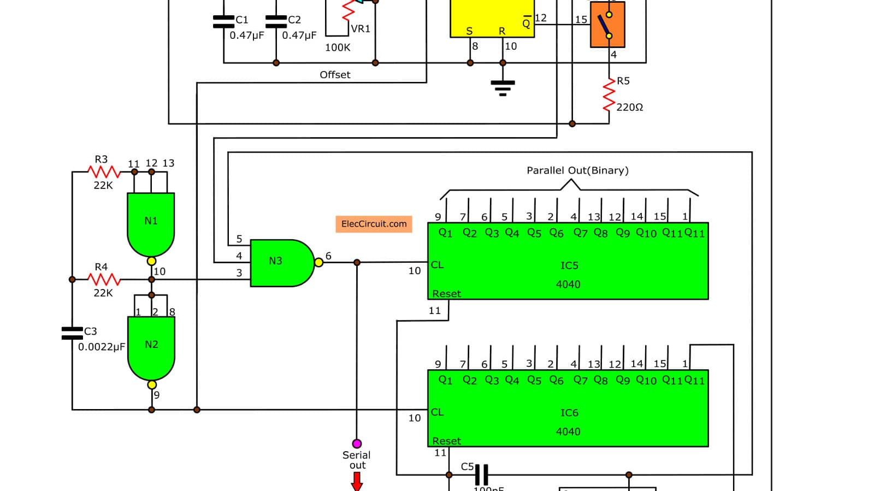
Digital Circuits
Flip-Flops

Slide 2

Objectives
At the end of the lesson student should be able to
State what is a logic circuit latch.
State that a logic circuit flipflop
Draw logic circuit for given flip flop
Draw truth table for given flipflops

Slide 3

Revision
A computer memory has the following properties
It should hold a value e.g., a 1-bit memory can hold a single bit 1 or 0
The value that is saved can be read. The bit that was saved can be read
The saved value can be changed. The saved bit is not constant
There is only one bit therefore there is only 2 options
Set the bit to 1
Reset, or clear the bit to 0

Slide 4
What are Flip Flops?
A flip-flop (edge-triggered) is a digital electronic circuit that functions as a basic memory unit, capable of storing a single bit of information (either a 0 or a 1). It has the ability to "remember" and hold its current state (0 or 1) until it receives a specific input signal, typically a clock pulse, instructing it to change.

Slide 5
How it works?
Imagine a light switch. It can be either ON or OFF, representing two states. A flip-flop is like a tiny electronic light switch inside a computer that also has two states:
1 (ON): This represents a binary value of 1.
0 (OFF):This represents a binary value of 0.
However, unlike a regular light switch, a flip-flop "remembers" its current state until it is told to change. This is crucial because computers use these states to store and process information in the form of 1s and 0s (binary code).

Slide 6
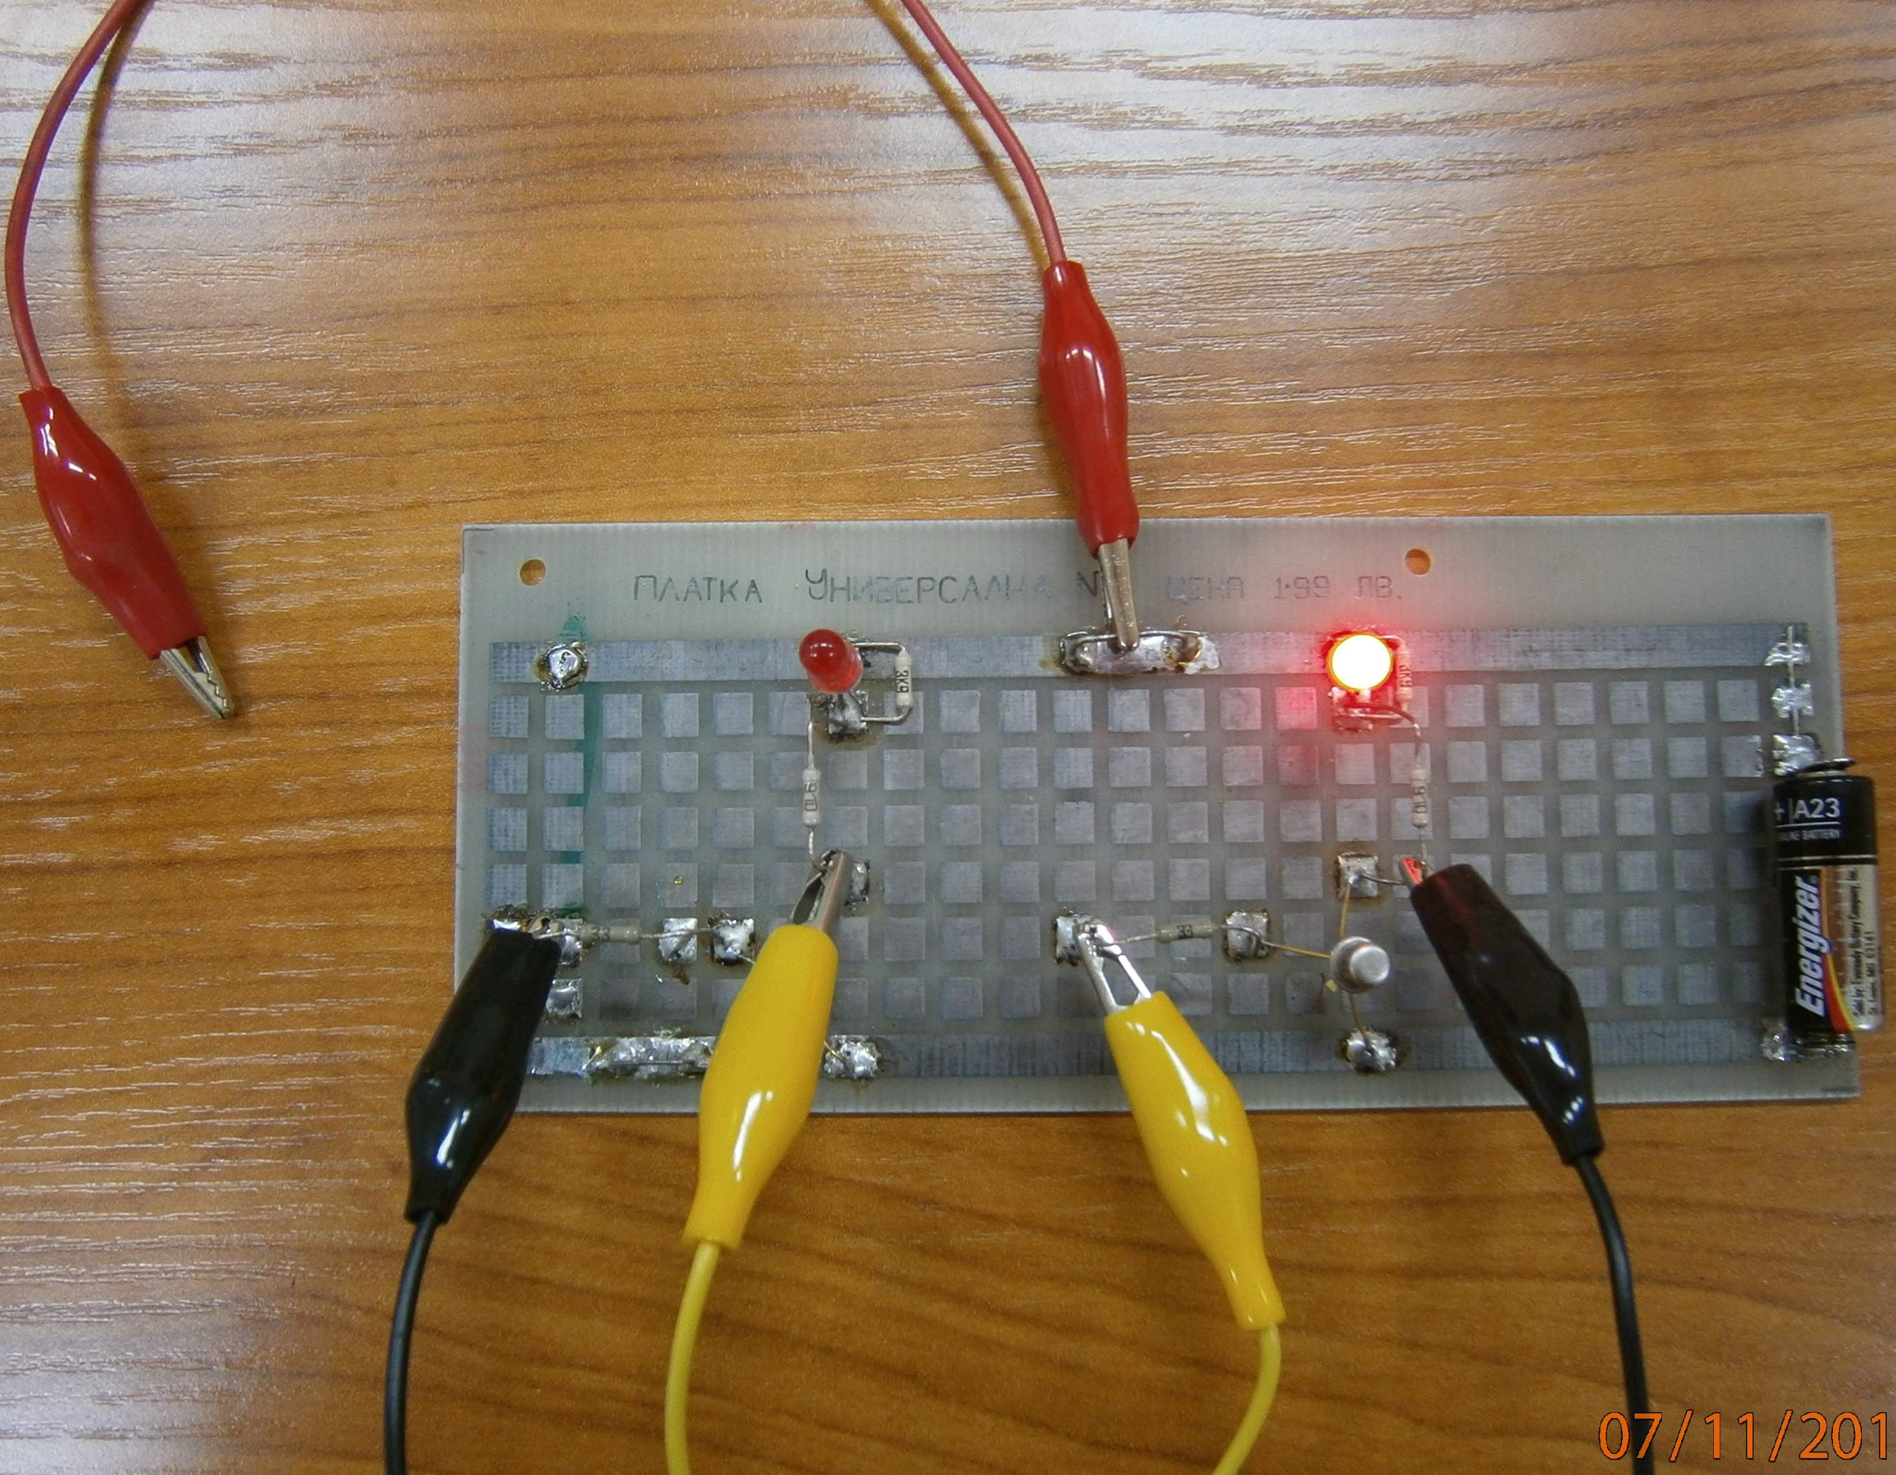

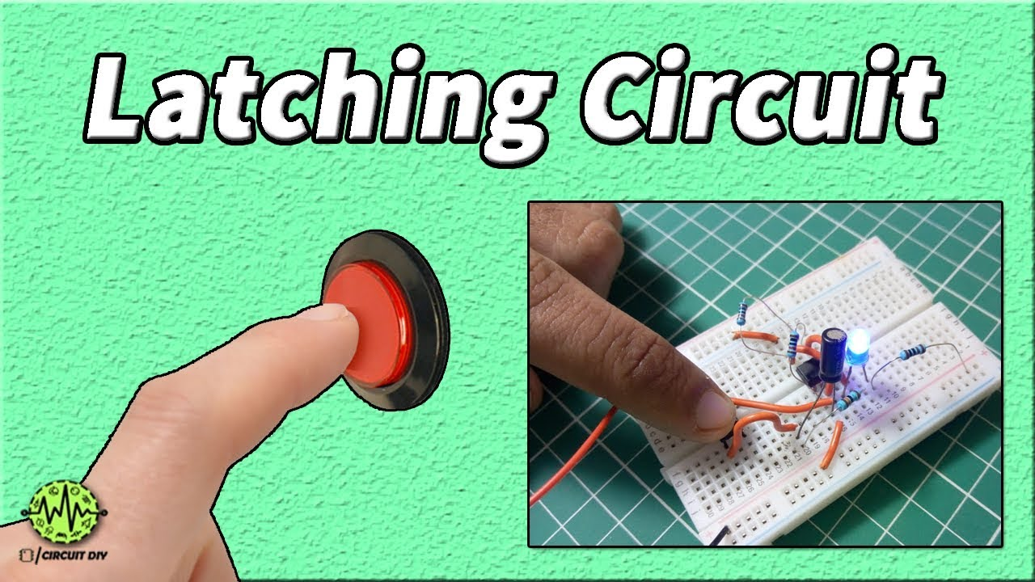
Flip-Flop
Flip-flops are built from latches they utilize the functionality of latches.
Flip-flops are built using logic gates- NAND and NOR
The gates take electrical signals as input and produce an output signal based on their arrangement.
The gates within a flip-flop allows it to hold a state (1 or 0) until it receives a specific input signal to change.

Slide 7
Why are flip-flops important?
Flip-flops form the basic building blocks of computer memory (RAM). Millions or billions of flip-flops work together to store data and programs that your computer needs to function.
Flip-flops can be connected to count events or cycles, like keeping track of clock signals.
They help synchronize different parts of a computer system by ensuring operations happen in the correct order.

Slide 8
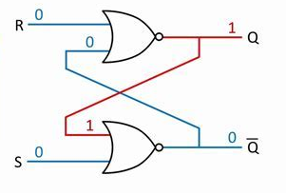
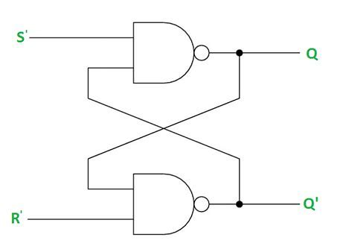
Types of Flip-Flops
SR Latch (Set-Reset Latch): The most fundamental latch type, forming the basis for more complex flip-flops.
D Flip-flop (Data or Delay Flip-flop): Most Common Type. It is widely used due to its simplicity and direct data storage capability.
JK Flip-flop: Versatile Control that offers more control over state transitions than D flip-flops.
T Flip-flop (Toggle Flip-flop): Specialized for Toggling that is designed specifically to toggle its output with each clock pulse

Slide 9
The SR Latch (Flip-Flop)
An SR flip-flop is essentially an SR latch with an additional clock input.
It allows the flip-flop to be edge-triggered, meaning it only responds to changes in the clock signal.
The SR flip-flop is also known as a Set-Reset flip-flop, is a basic type of latch, which is a basic electronic circuit that can store one bit of information (0 or 1).
It has two inputs, Set (S) and Reset (R), that directly control the state of its output (Q)

Slide 10
The SR Latch (Flip-Flop)
The JK flip-flop is like a controllable memory cell with a light bulb inside. The J and K inputs let you set (turn on) or reset (turn off) the bulb, but only when the clock "guard" allows it.
Q and Q' indicators tell you the current state of the bulb without letting you peek inside!

Slide 11
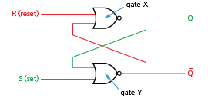
The S-R (Latch) Flip Flop
The circuit has two inputs, labelled S and R.
S is used to SET the device
R is used to RESET the device.
The circuit also has two outputs —Q and not Q.
This is the most common type.
The output from gate ‘X’ is Q
The output from gate ‘Y’ is Q.
The inputs to gate ‘X’ are R and Q
The inputs to gate ‘Y’ are S and Q
The output from each NOR gate gives a form of positive feedback known as cross-coupling

Slide 12
The SR Latch (Flip-Flop)
An SR flip-flop is essentially an SR latch with an additional clock input.
It allows the flip-flop to be edge-triggered, meaning it only responds to changes in the clock signal.
How to create a SR flip flop
To create an SR flip-flop, start with an SR latch and add the clock input.
This modification ensures that the flip-flop's state changes only occur at specific points in time, synchronized with the clock signal.
This makes the behavior of the flip-flop more controlled and predictable, which is crucial in digital systems.

Slide 13
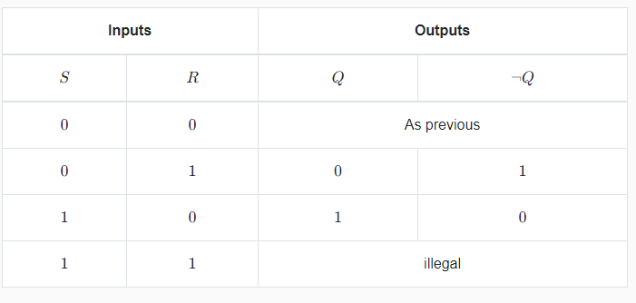
SR Flip Flop
The SR flip flop has four possible states, depending on the values of S and R:
If S = 0 and R = 0, the SR flip flop remains in its previous state. The hold state.
If S = 0 and R = 1, the SR flip flop resets its output Q to 0 and Q’ to 1. The reset state.
If S = 1 and R = 0, the SR flip flop sets its output Q to 1 and Q’ to 0. The set state.
If S = 1 and R = 1, the SR flip flop enters an invalid state, where both Q and Q’ are 0. This is also called a race condition, because the output depends on which gate responds faster.

Slide 14
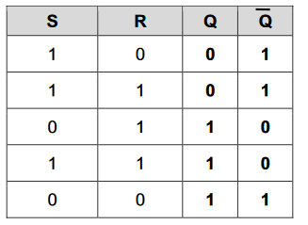
SR Flip Flop
The SR flip flop has four possible states, depending on the values of S and R:
If S = 0 and R = 0, the SR flip flop remains in its previous state. The hold state.
If S = 0 and R = 1, the SR flip flop resets its output Q to 0 and Q’ to 1. The reset state.
If S = 1 and R = 0, the SR flip flop sets its output Q to 1 and Q’ to 0. The set state.
If S = 1 and R = 1, the SR flip flop enters an invalid state, where both Q and Q’ are 0. This is also called a race condition, because the output depends on which gate responds faster.

Slide 15
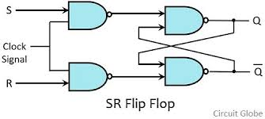
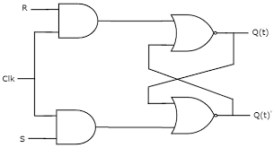
S-R Flip-Flop
Inputs to the S R Flip Flops
Set (S): This input sets the flip-flop when it receives a positive transition (e.g., from 0 to 1) while the clock is active.
Reset (R): This input resets the flip-flop when it receives a positive transition while the clock is active.
Clock (CLK): This input serves as a control signal. The flip-flop only responds to changes in S and R when the clock signal undergoes a specified transition (either rising edge or falling edge, depending on the flip-flop type).

Slide 16
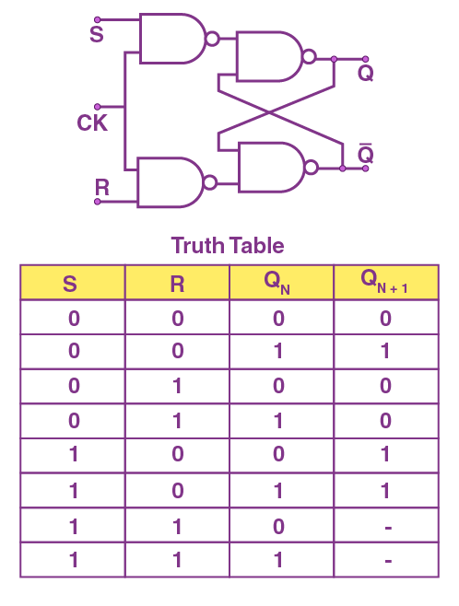
S-R Flip-Flop
Outputs:
Q: This is the output of the flip-flop, representing its current state (1 or 0).
~Q (Not Q): This is the complement of Q.
If Q is 1, ~Q will be 0, and vice versa.
The S input sets the output Q to 1, and the R input resets the output Q to 0.
The output Q’ is always the complement of Q, meaning it has the opposite value.

Slide 17
SR Flip Flops
When the clock signal undergoes the specified transition (rising or falling edge), the flip-flop checks the values of S and R.
If S = 1 and R = 0 during the active clock transition, the flip-flop is set (Q = 1).
If R = 1 and S = 0 during the active clock transition, the flip-flop is reset (Q = 0).
If both S and R are 0, the flip-flop holds its current state.
If both S and R are 1 during the active clock transition, it enters a "forbidden" state, which should be avoided.

Slide 18
The SR Flip-Flop
Think of an SR flip-flop like a little box with two switches inside. "S" and "R":
S (Set): This is like the "turn on" switch. When you press it, it sets the flip-flop to "1" (meaning on).
R (Reset): This is like the "turn off" switch. When you press it, it resets the flip-flop to "0" (meaning off).
Two Outputs: "Q" and “ Not Q":
Q: This is like a little light inside the box. When it's on, it means the flip-flop remembers a "1".
¬Q (Not Q): This is like another little light, but it shows the opposite. When Q is on, ¬Q is off, and vice versa.
Once you press S or R, the flip-flop stays in that state until you press the other switch.
If you press both S and R at the same time, it might cause unpredictable behavior, like a light flickering

Slide 19
SR Flip Flop
The truth table of an SR flip flop shows the relationship between the inputs and outputs
The characteristic table of an SR flip flop shows the relationship between the current state and the next state
S | R | Q | Q’
0 | 0 | Q | Q’
0 | 1 | 0 | 1
1 | 0 | 1 | 0
1 | 1 | 0 | 0
Qn | Qn+1 | S | R
0 | 0 | 0 | X
0 | 1 | 1 | X
1 | 0 | X | 1
1 | 1 | X | 0

Slide 20
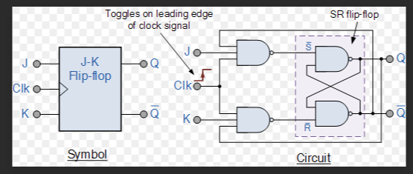
J K Flip Flops

Slide 21
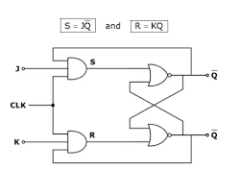
JK Flip-Flop
J k Flip Flop is named after its inventor, Jack Kilby.
It is the most widely used flip-flop.
It is more stable than an SR flip-flop
It is an extension of the SR (Set-Reset) flip-flop, offering additional functionality and solving some of the issues associated with the SR flip-flop.
It has two inputs (J and K) in addition to the clock signal (Clk), it has four functions — SET, RESET, HOLD, and TOGGLE.

Slide 22
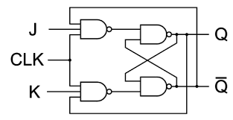
JK Flip Flop
A JK flip-flop is a type of sequential logic circuit that can store one bit of binary information (i.e., a 0 or a 1) and can change its output based on the values of its input signals.
It has two inputs, J and K, and two outputs, Q and Q’.
The J input sets the output Q to 1, and the K input resets the output Q to 0.
The output Q’ is always the complement of Q, meaning it has the opposite value.
The JK flip-flop can be triggered by a clock signal, which determines when the output changes according to the input.

Slide 23
How the JK Flip-Flop works
Like the SR flip-flop with a clock, the JK flip-flop responds to changes in J and K only when the clock signal undergoes a specified transition (either rising edge or falling edge, depending on the type).
The JK flip-flop has an additional mode of operation that makes it different from the SR flip-flop:
When both J and K inputs are active (1), it toggles its output. This means that if Q is 1, it will become 0, and if Q is 0, it will become 1.

Slide 24
JK Flip Flop
The JK flip-flop has four possible states, depending on the values of J and K:
If J = 0 and K = 0, the JK flip-flop remains in its previous state. The hold state.
If J = 0 and K = 1, the JK flip-flop resets its output Q to 0 and Q’ to 1. The reset state.
If J = 1 and K = 0, the JK flip-flop sets its output Q to 1 and Q’ to 0. The set state.
If J = 1 and K = 1, the JK flip-flop toggles its output Q from 0 to 1 or from 1 to 0, depending on its previous state. This is also called a race condition, because the output depends on which gate responds faster.

Slide 25
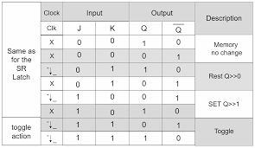
JK Flip Flop Truth Table

Slide 26
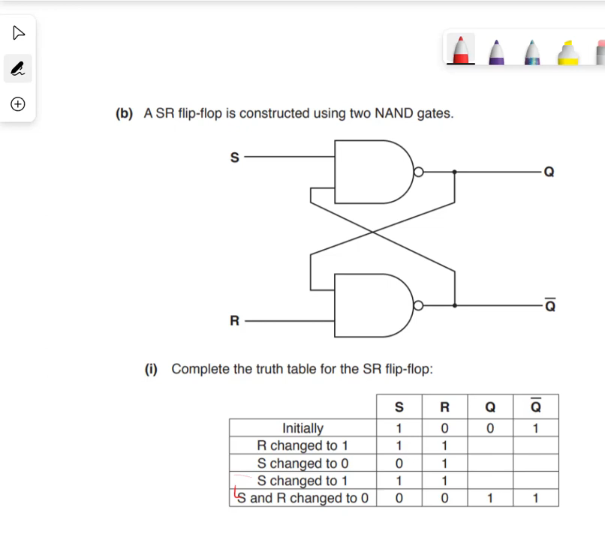
Video

Slide 27
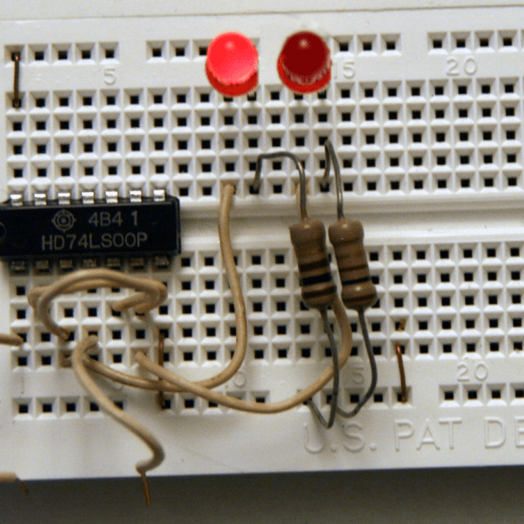

Students’ Concept Development
Research on the other types of flip flops
D-Flip Flop
T- Flip Flop

Slide 28
JK Flip Flop
There are two types of JK flip-flops:
positive-edge triggered
negative-edge triggered.
A positive-edge triggered JK flip-flop changes its output on the rising edge of the clock signal, while a negative-edge triggered JK flip-flop changes its output on the falling edge of the clock signal.

